Slide 1
Roots and Soil
Microclimates – elevation, etc.
Edge Effects and Island Biogeography Theory – Intermediatary Disturbance Theory
Hydraulic Lift – discuss on walk
Planet Earth clips, go outside

Slide 2
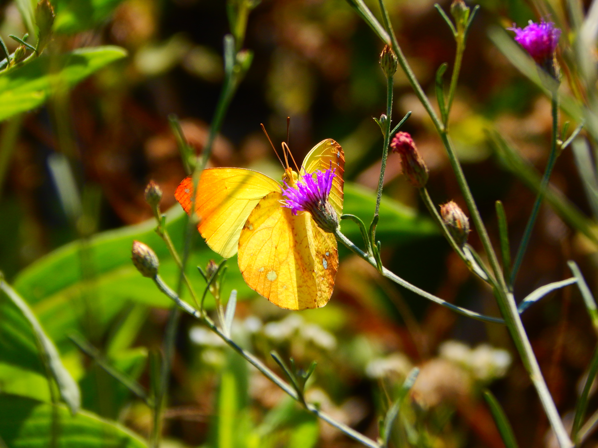
WOODY PLANT BASICS:
ECOLOGY
Led by Cat Chamberlain, Wayne Daly

Slide 3

MAIN AIMS
Quick Update from last week...
Ecology: defined
Succession & Recruitment
Ecological Relationships
Conservation

Slide 4
ECOLOGY:
the study of how organisms interact with their environment and other organisms.
ABIOTIC: non-living, environmental factors
BIOTIC: living organisms and their interactions
Precipitation
Wind
Soil
Water availability
Temperature
Sunlight
Humidity
https://lakesuperiorbiology.weebly.com/biotic-factors.html

Slide 5
ECOSYSTEM

Slide 6
ECOLOGICAL SUCCESSION

Slide 7
ECOLOGICAL SUCCESSION
Notes:
David clip - https://vimeo.com/179942639 -- Start at 21:20 - 22:50

Slide 8
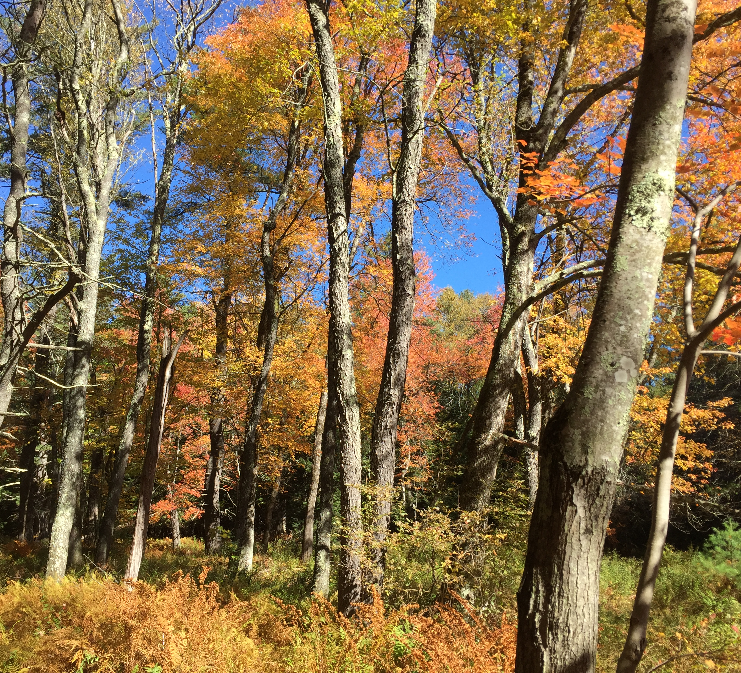
RECRUITMENT: when new individuals find a population or are added to an existing population
Seedling Recruitment:
3 Stages
Germination
Survivorship
Growth

Slide 9
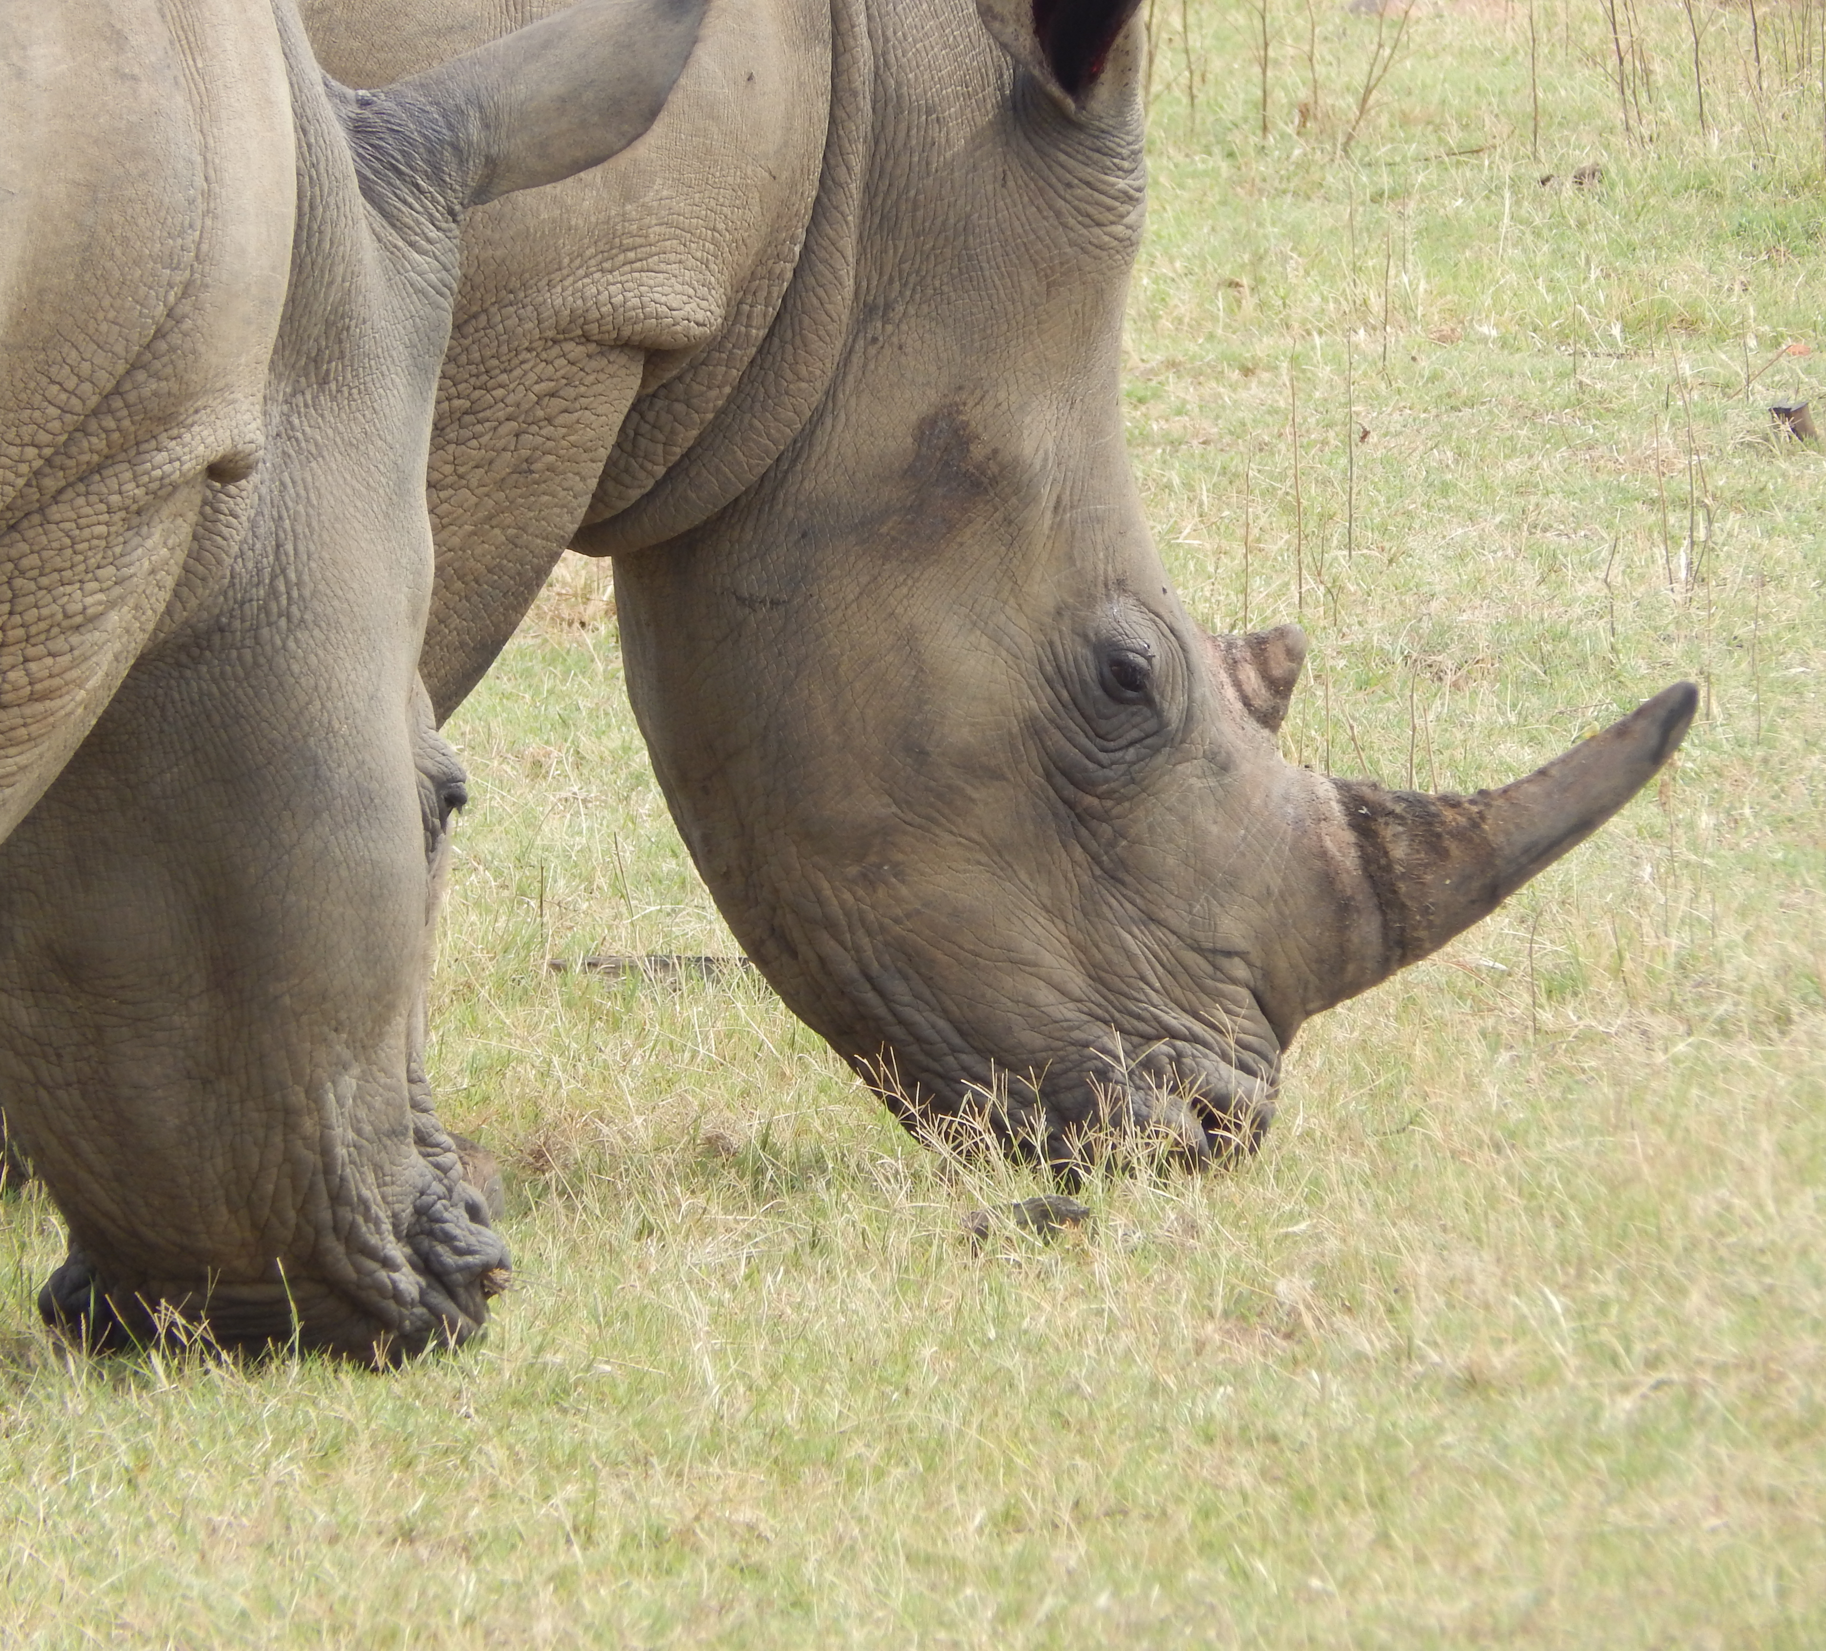
Ecological Relationships
Competition
Parasitism
Predation & Herbivory
Mutualism
Commensalism

Slide 10
COMPETITION
Notes:
http://www.bbc.co.uk/programmes/p0038s03 – watch video on light competition

Slide 11
PARASITISM
Photo: Nancy Rose
Photo: Whitney Cranshaw
Witches’ Broom
on Celtis occidentalis
Witches’ Broom on Lonicera
Tar Spot
Beech Drops
Notes:
Witches’ brooms can be caused by aphids, powdery mildew, mites
Tar Spot – biotrophic (needs host to stay alive)

Slide 12
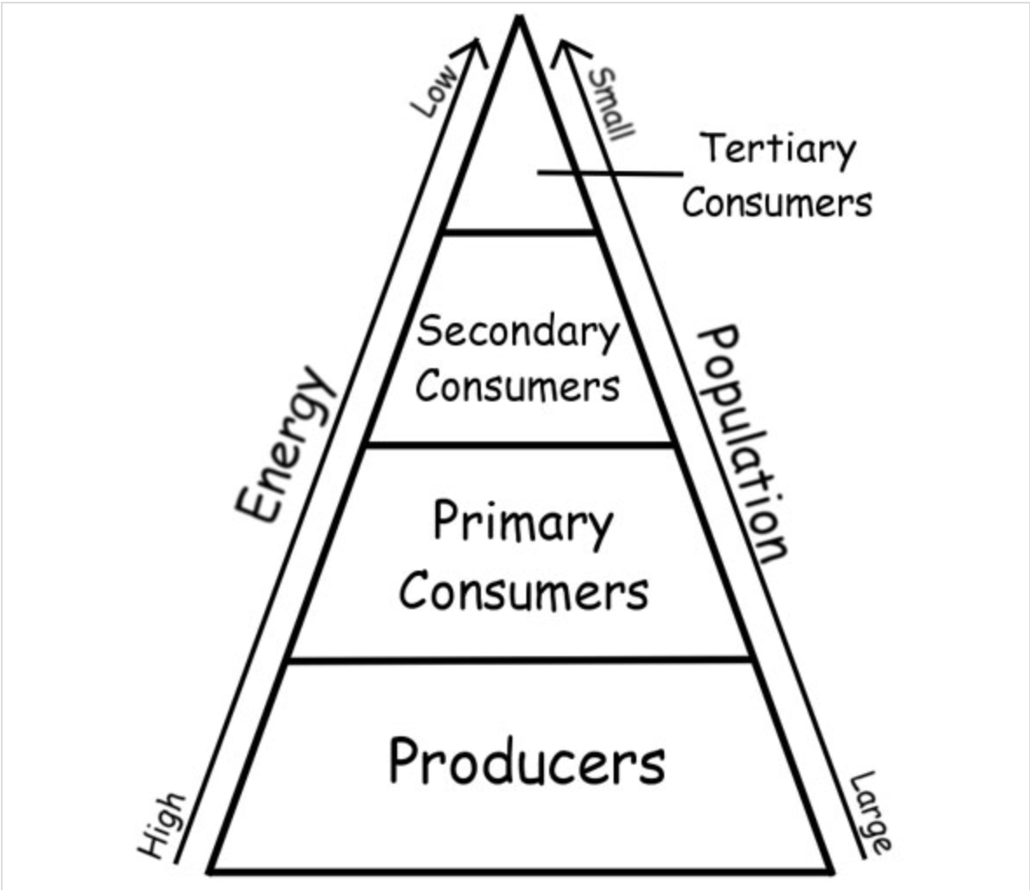
PREDATION: Trophic Cascades
http://cleangreenenergyzone.com/significant-levels-of-energy-pyramid-ecosystem/

Slide 13
Adaptations to Predation
Notes:
Viceroys are highly palatable to birds – talk about Batesian mimicry and introduce Müllerian mimicry
Batesian Mimicry is actually also a form of parasitism because it adversely affects the other butterfly

Slide 14
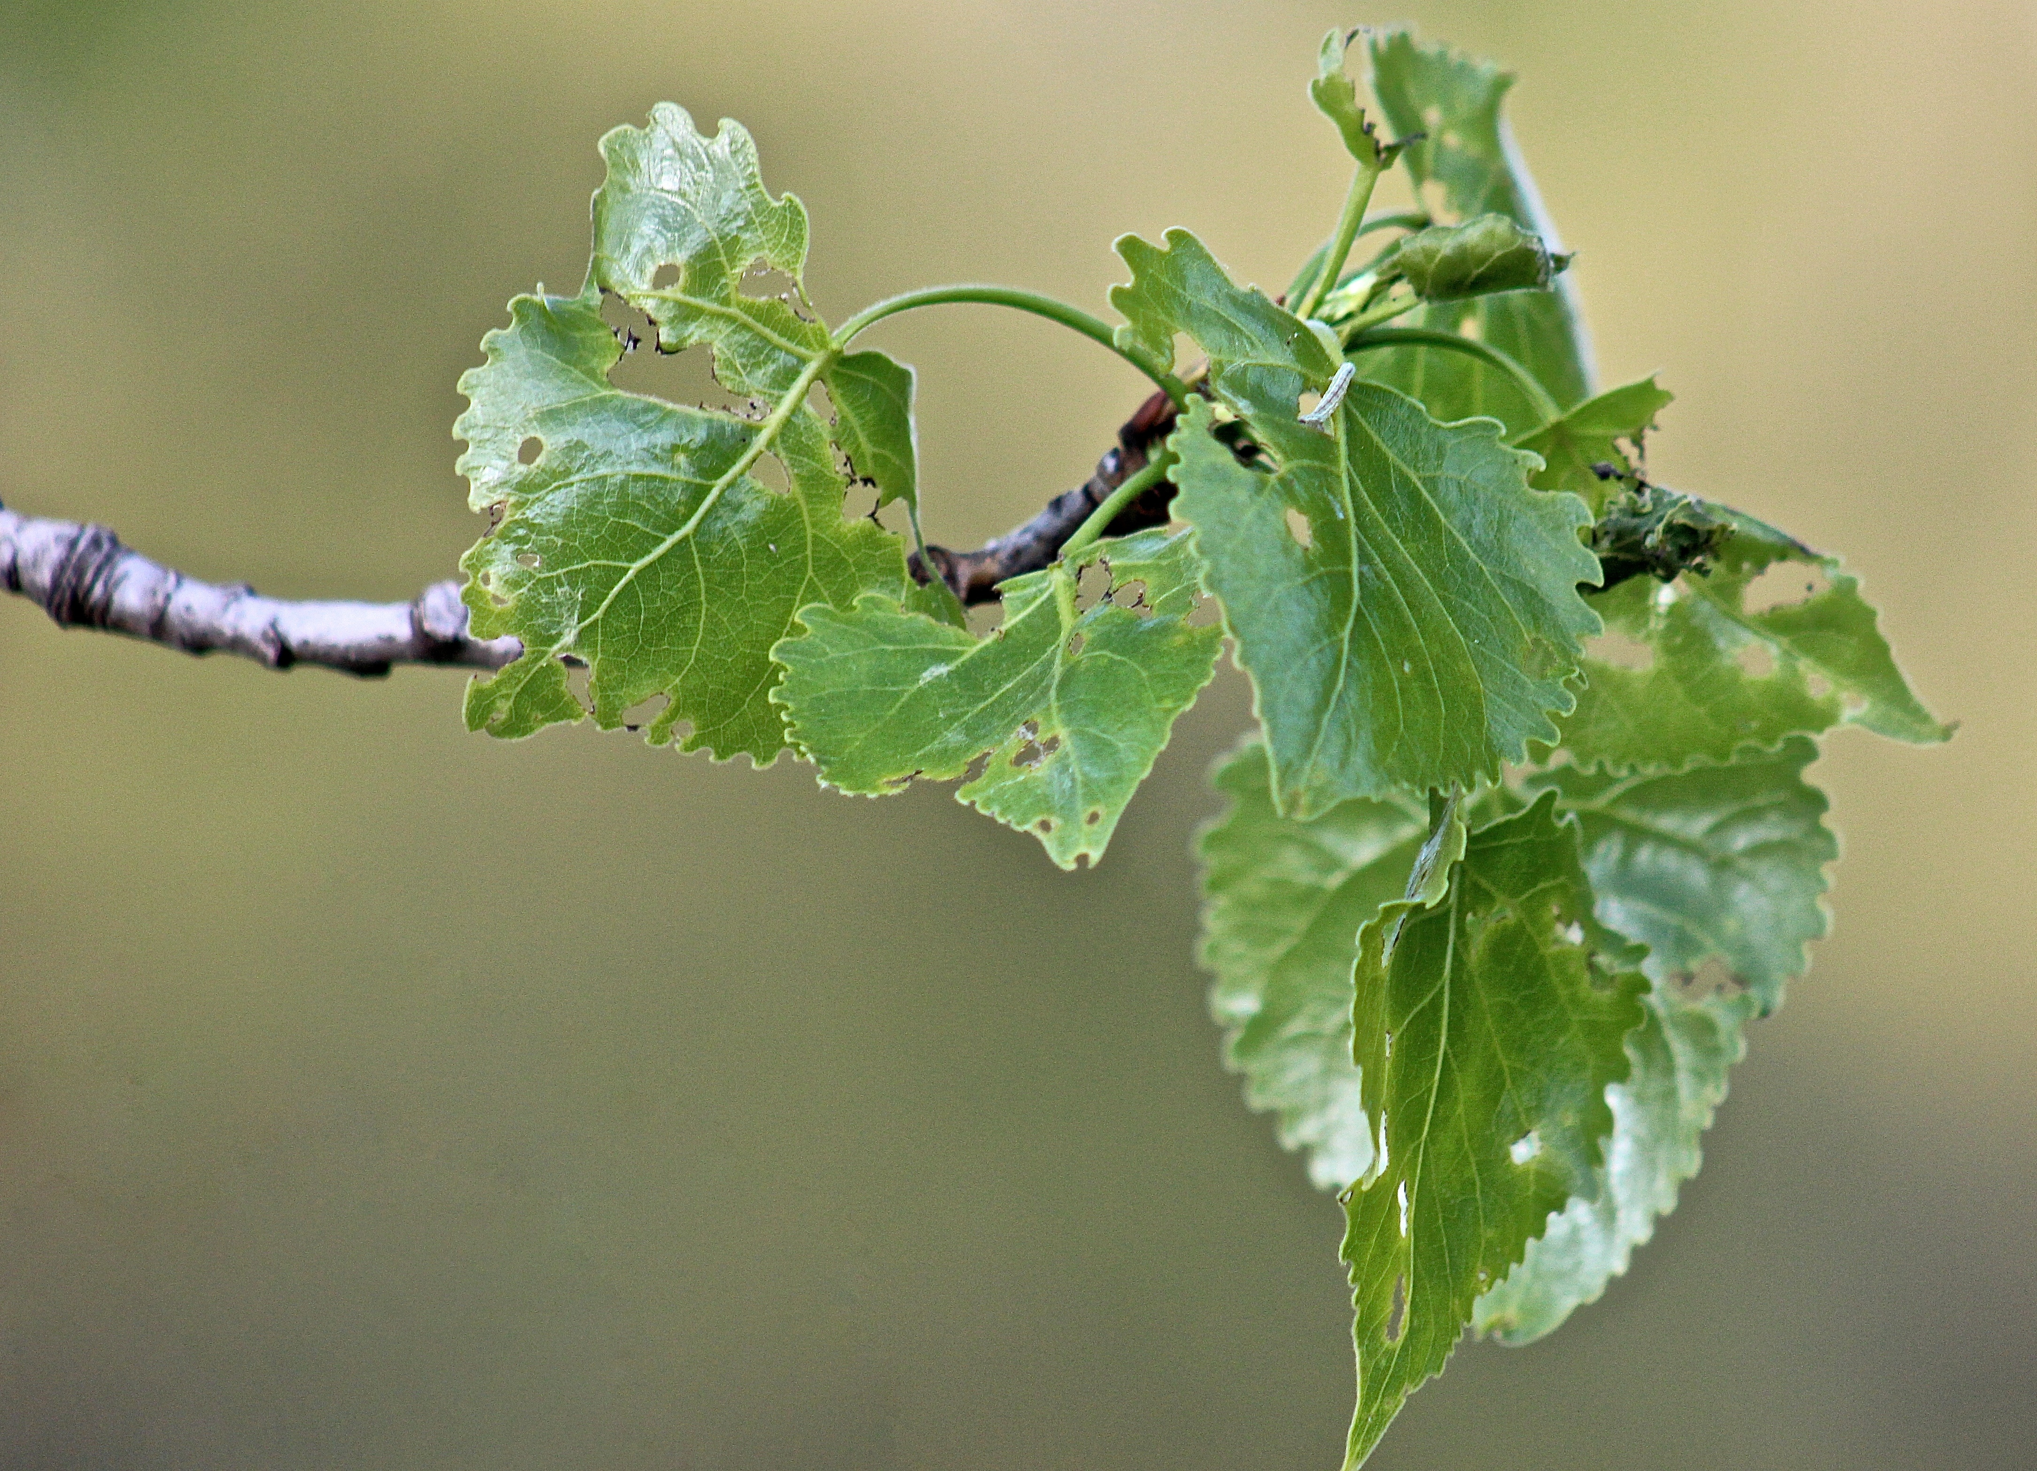
HERBIVORY
WINTER MOTH
Populus deltoides
Photo: Suz Mrozak

Slide 15
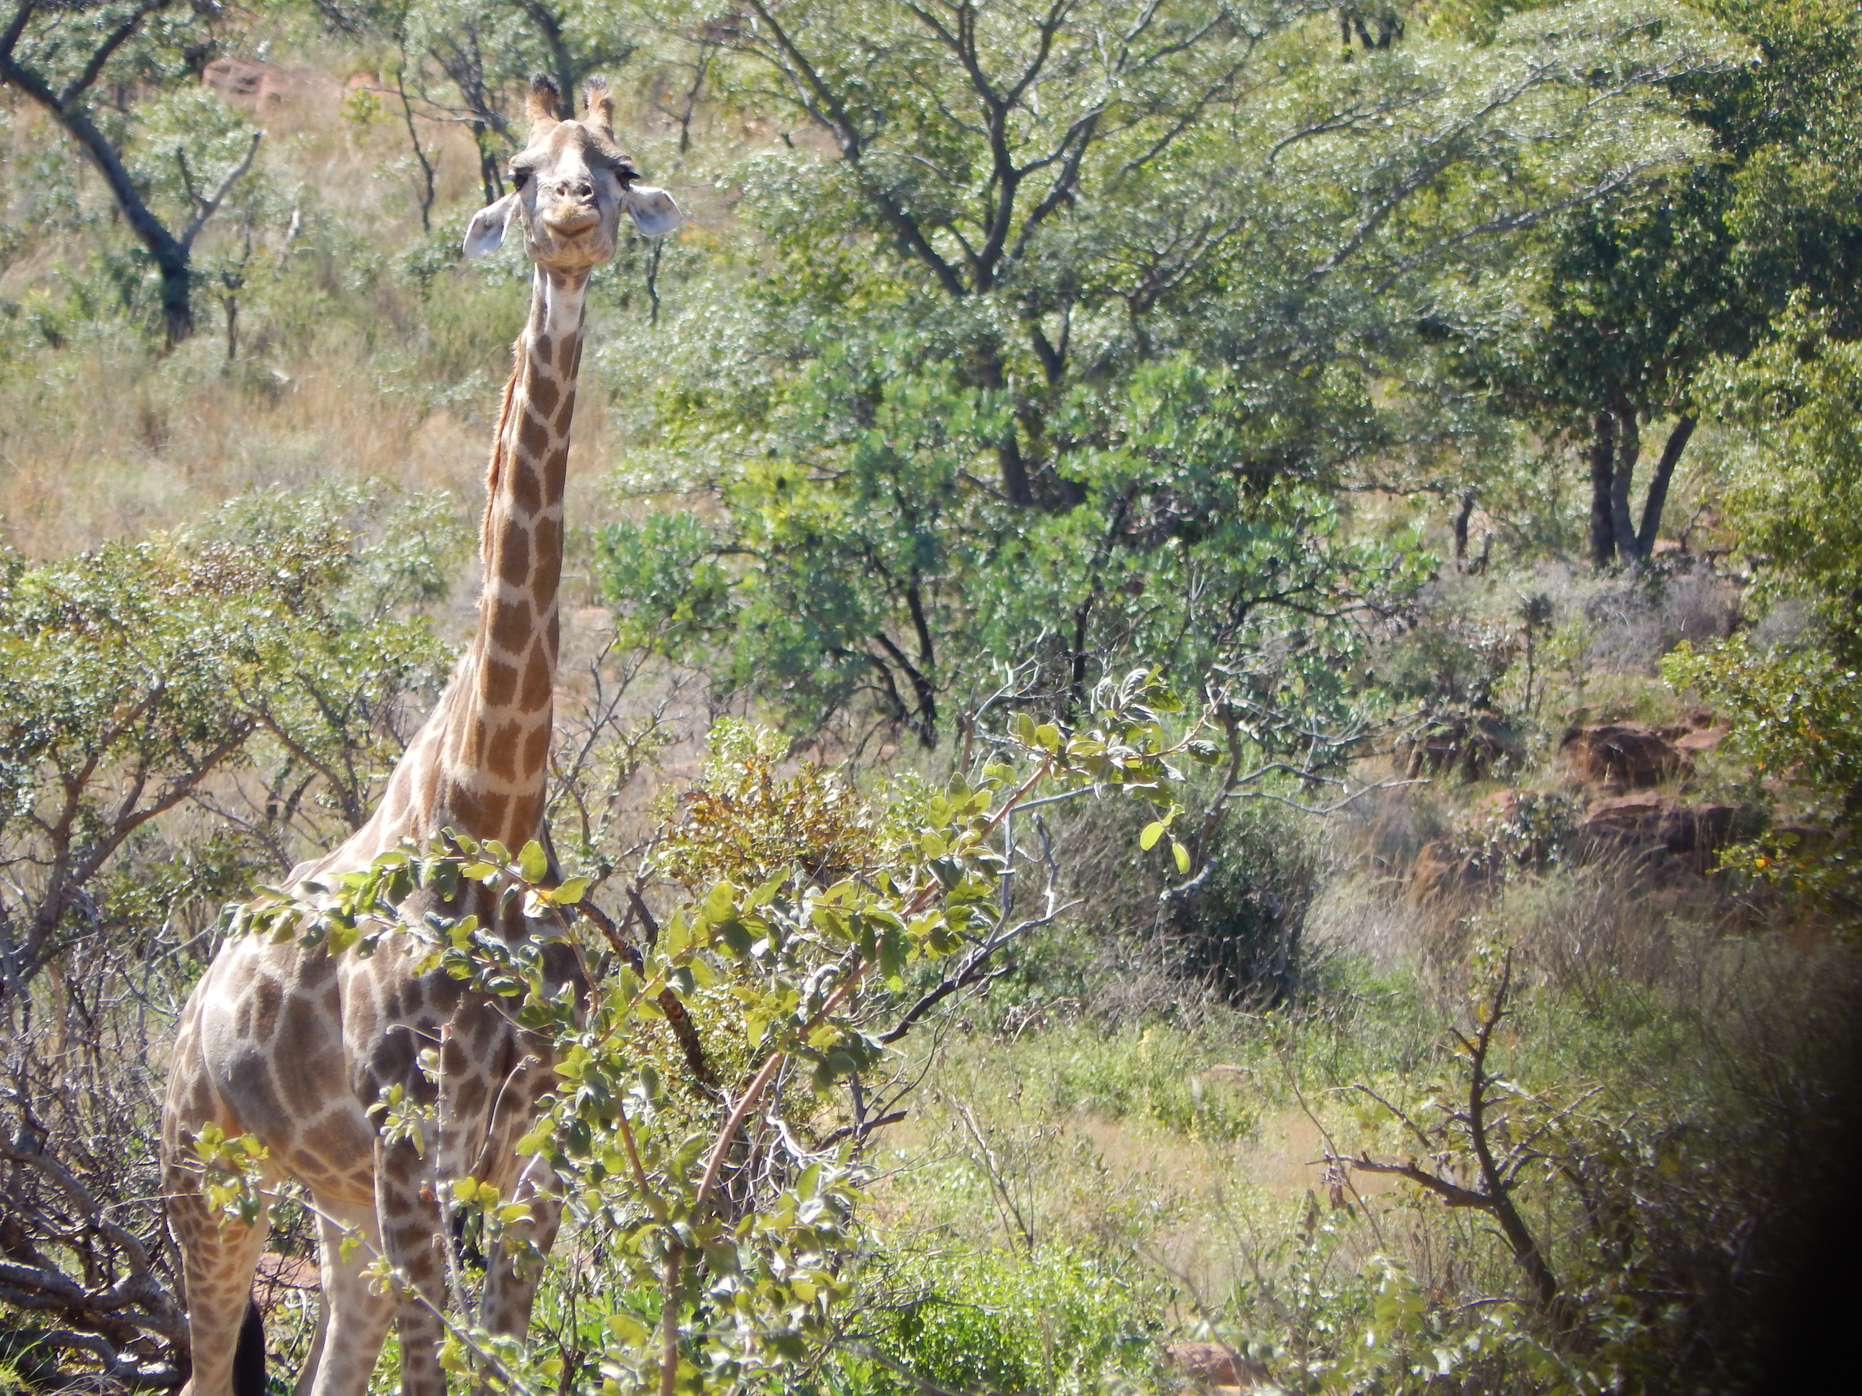
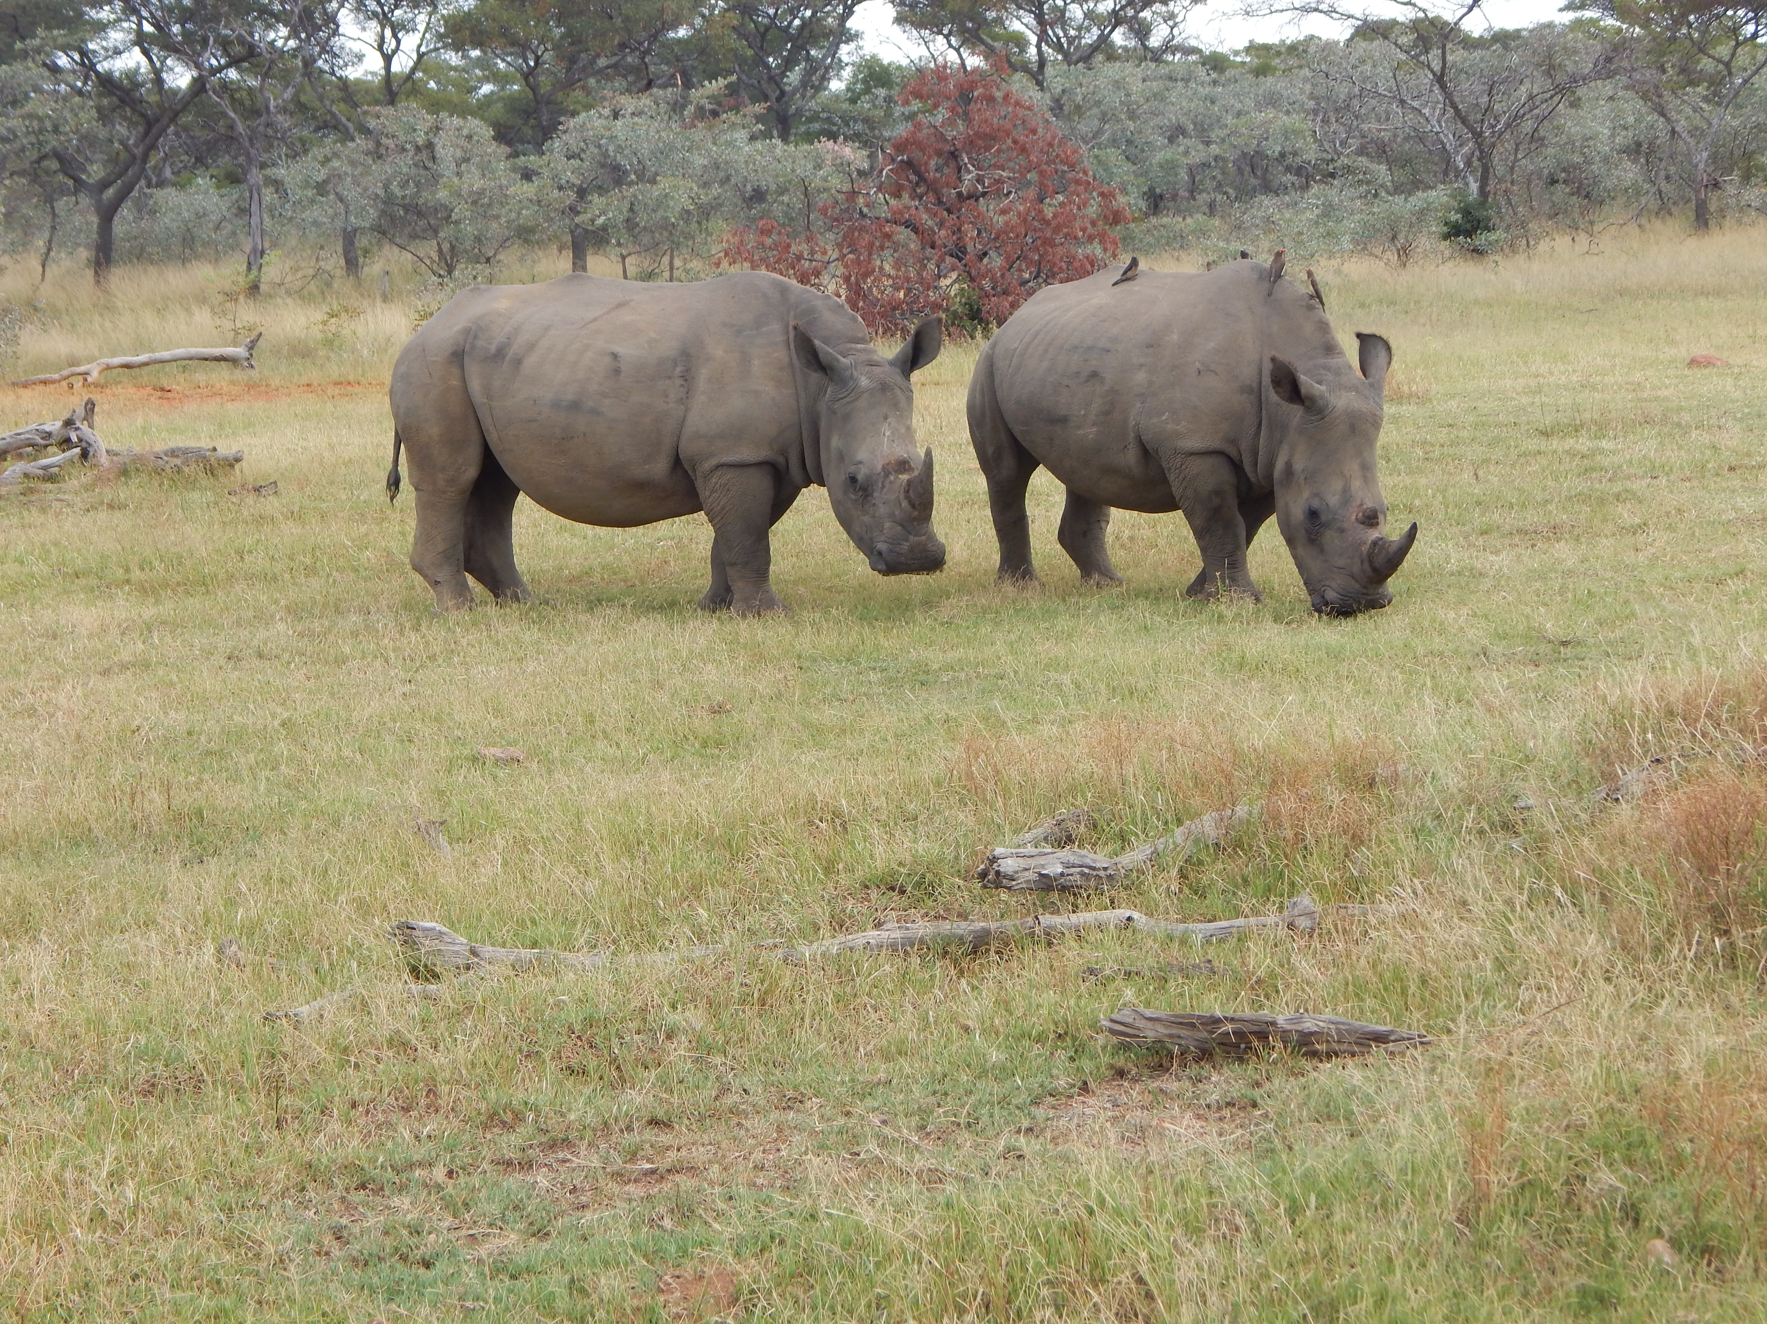
HERBIVORY
BROWSERS: moose, deer
GRAZERS: bison, cows, sheep
Notes:
Plant defenses: thorns and chemicals (e.g. tannins) or cocaine and nicotine
Herbivores: butterflies have chemical sensors on feet so they can taste before eating, mammals can smell and tend to eat younger leaves due to lower levels of harmful chemicals in them

Slide 16
MUTUALISM
POLLINATION
MYCORRHIZAL NETWORKS

Slide 17
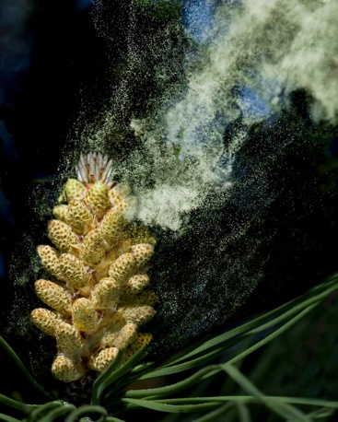
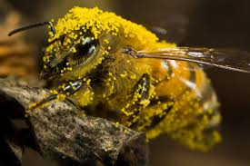
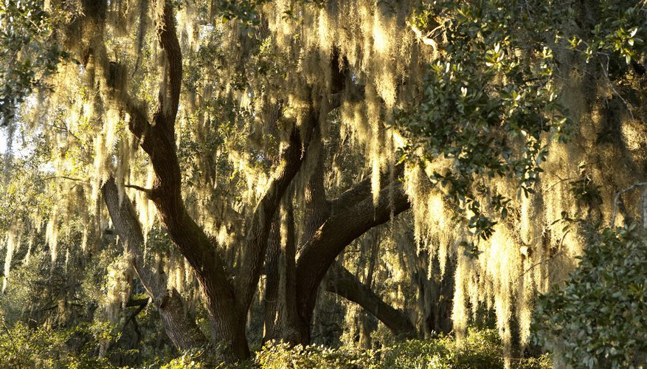
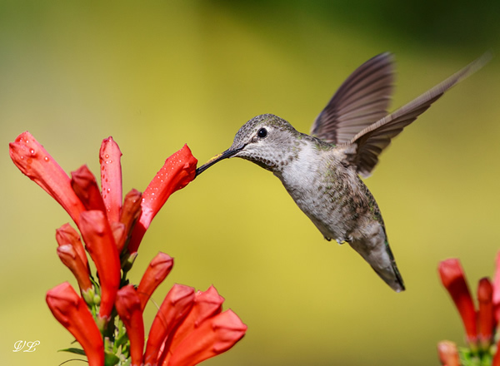
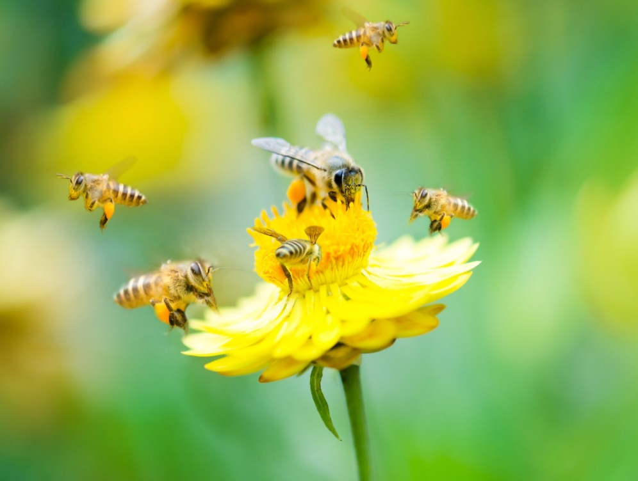
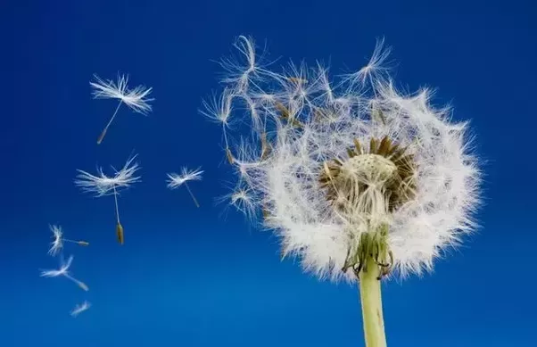
POLLINATION

Slide 18
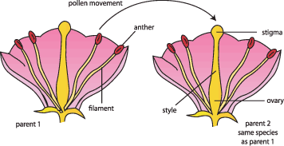
What is Pollination
Transfer of pollen from stamen to a stigma, ovule, flower, or plant to allow fertilization

Slide 19
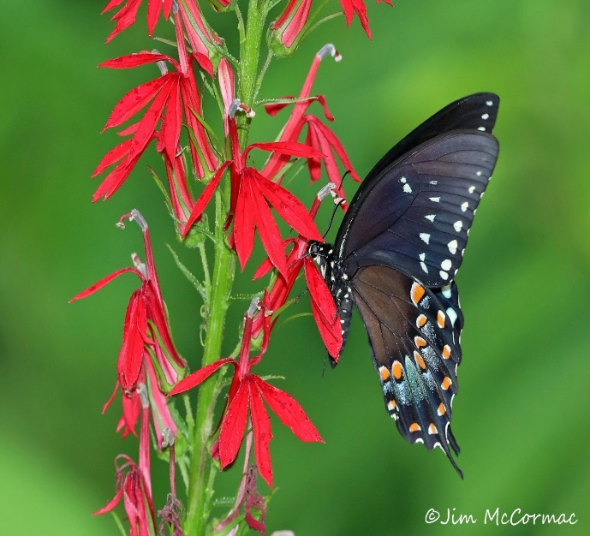
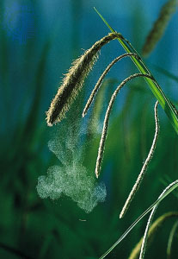
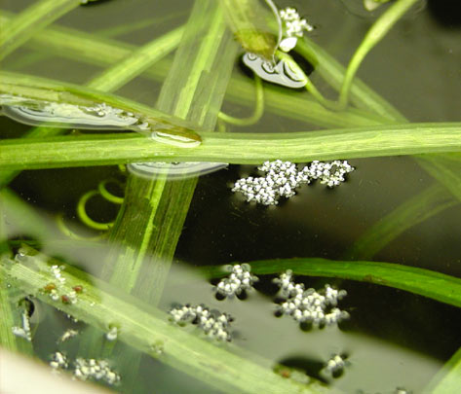
Movement of Pollen
Biotic
ANIMAL
Abiotic
WIND
WATER
Pollen Grains Immobile
Need external agent to reach stigma

Slide 20
BIOTIC
Pollen transferred from plant to plant by way of an animal
Most flowering plants
Usually occurs in the form of mutualism

Slide 21
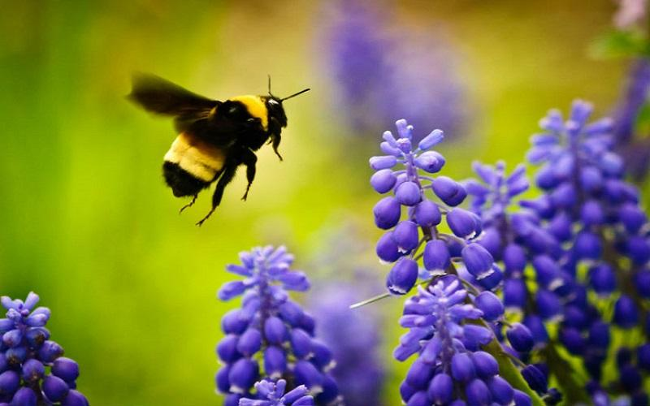
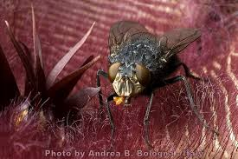
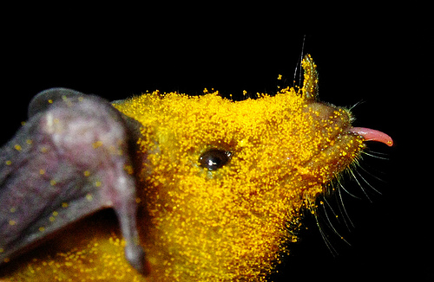
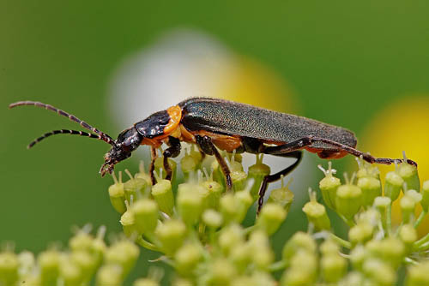
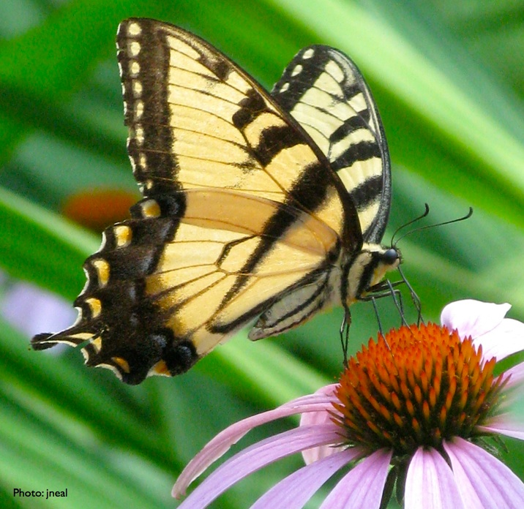
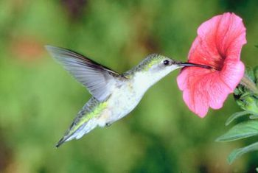
BIOTIC

Slide 22
ABIOTIC
No need to attract pollinators
Plant produces a lot of pollen
More common in colder climates

Slide 23
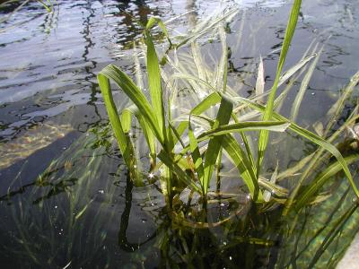
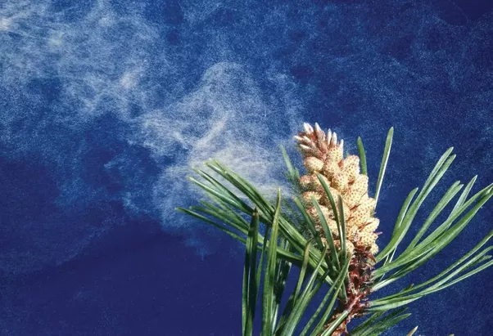
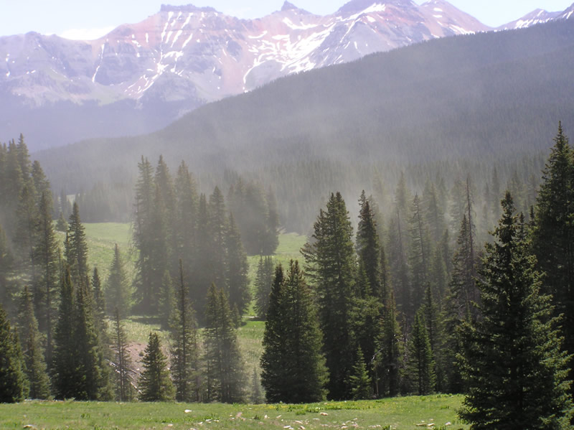
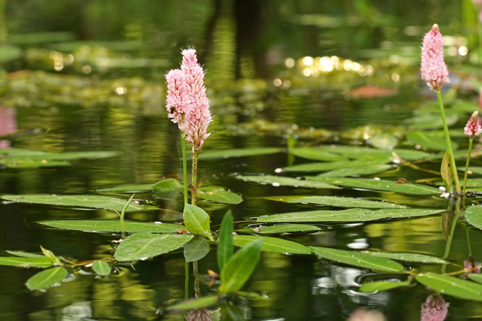
ABIOTIC

Slide 24
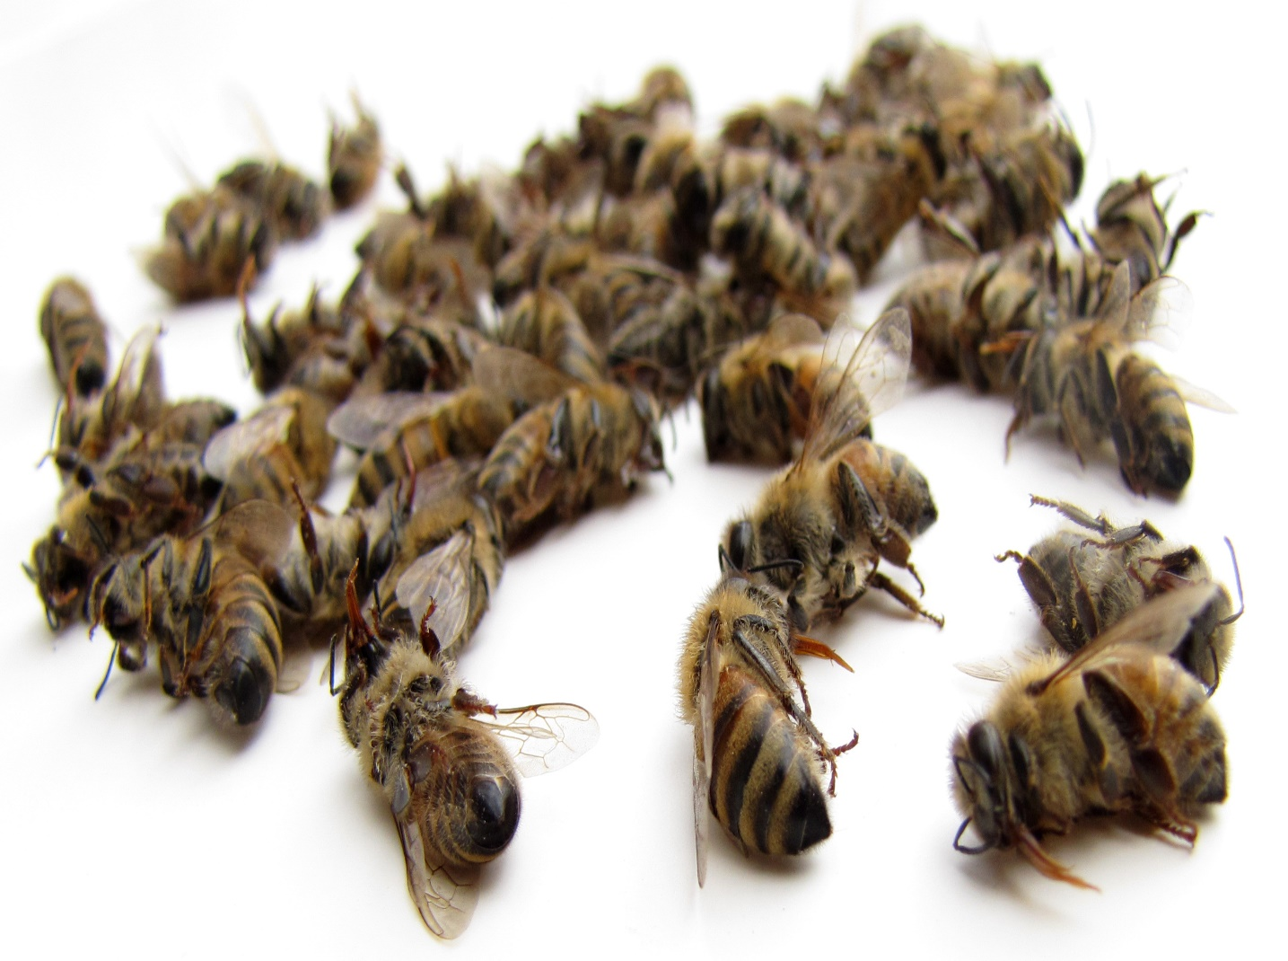
Pollinator Decline
Anthropogenic Pressure
Massive consequences for Humans

Slide 25
What can we do?
Wide Variety of plants – mixture of colors and shapes
Connectivity and green space
Use pollinator friendly presticides – e.g. Neem oil
Spread the word!

Slide 26
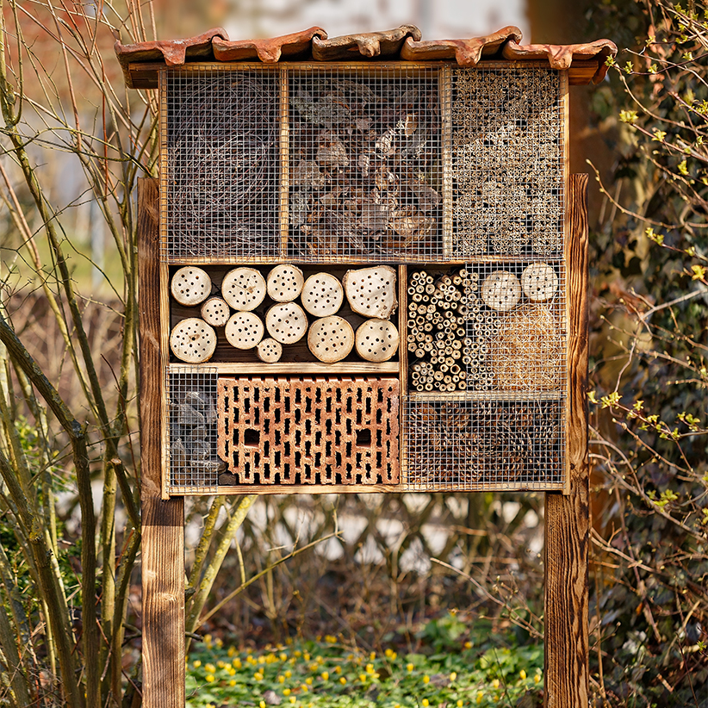
Bee Hotel

Slide 27
Without Mycorrhizae
With Mycorrhizae
MUTUALISM
Less efficient roots
Mykos = fungus
Rhiza = root
Unstable soil
Help contain water, nutrients, stabilize soil, increase efficiency
Water and nutrients more likely to leak

Slide 28
MYCORRHIZAE
Communication Network:
Herbivory
Masting Events
Disease
http://www.gardenopoliscleveland.org/

Slide 29
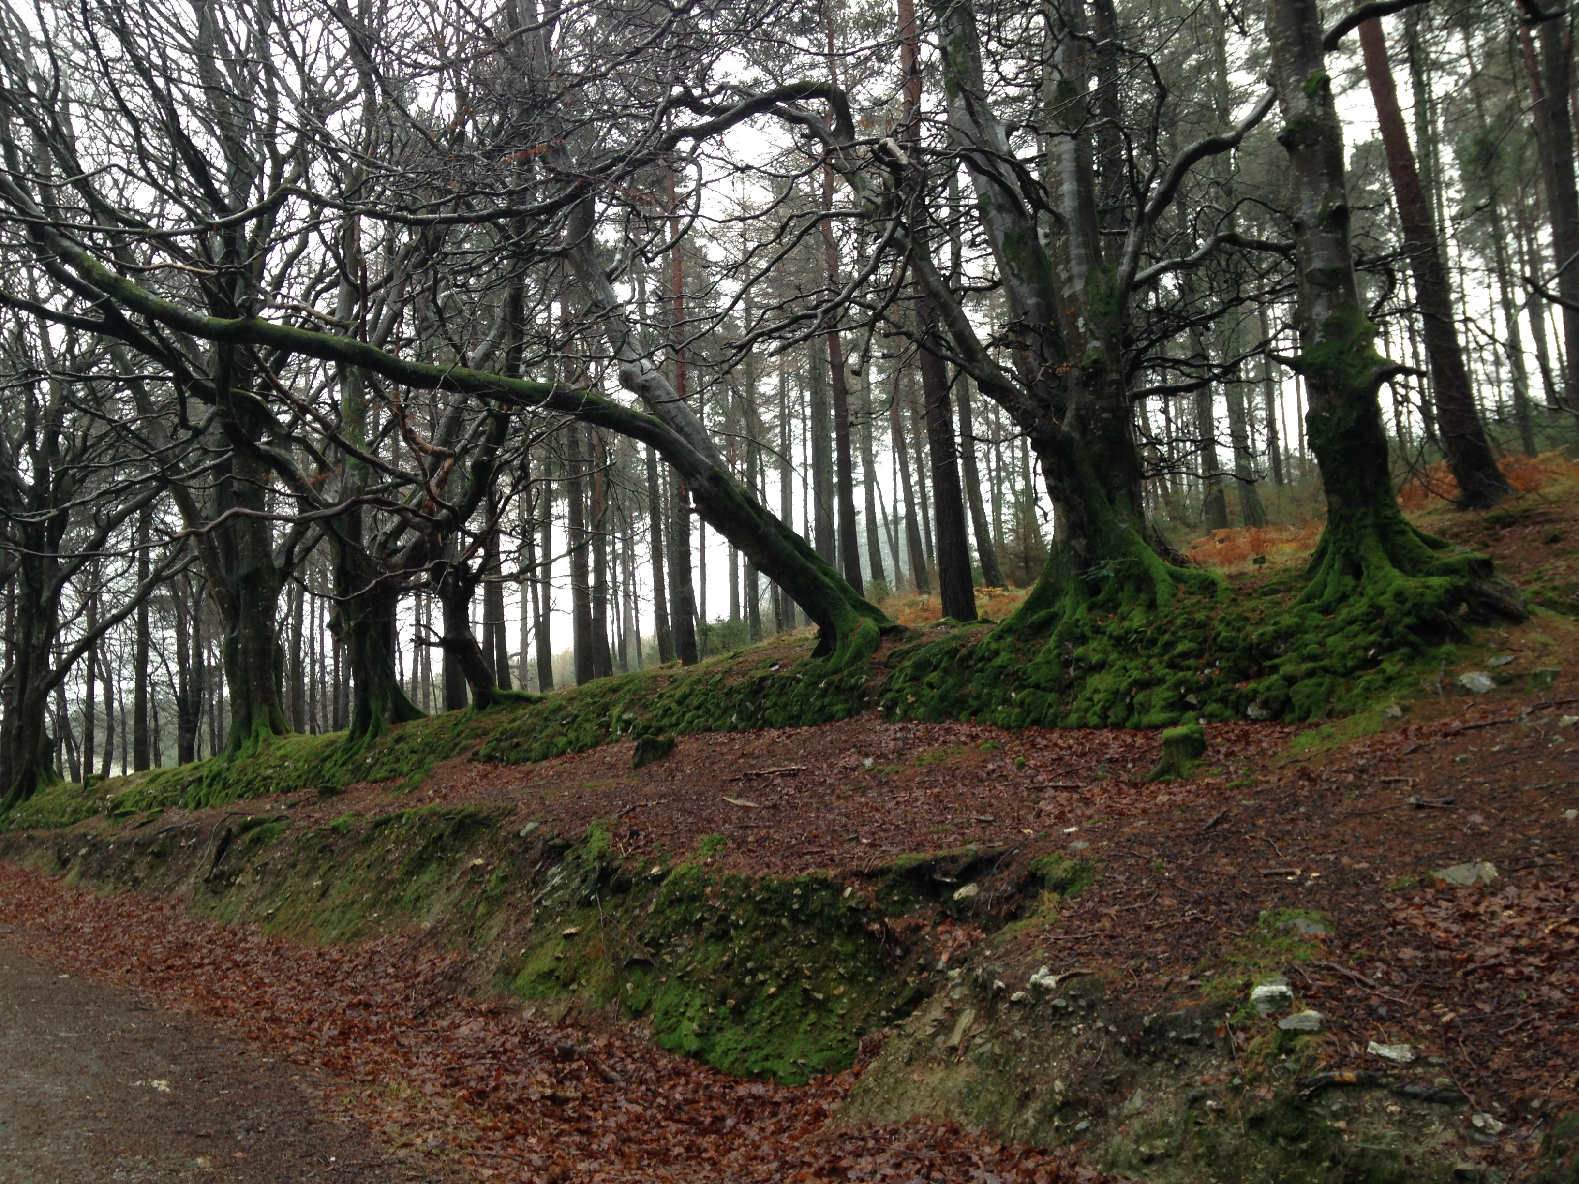
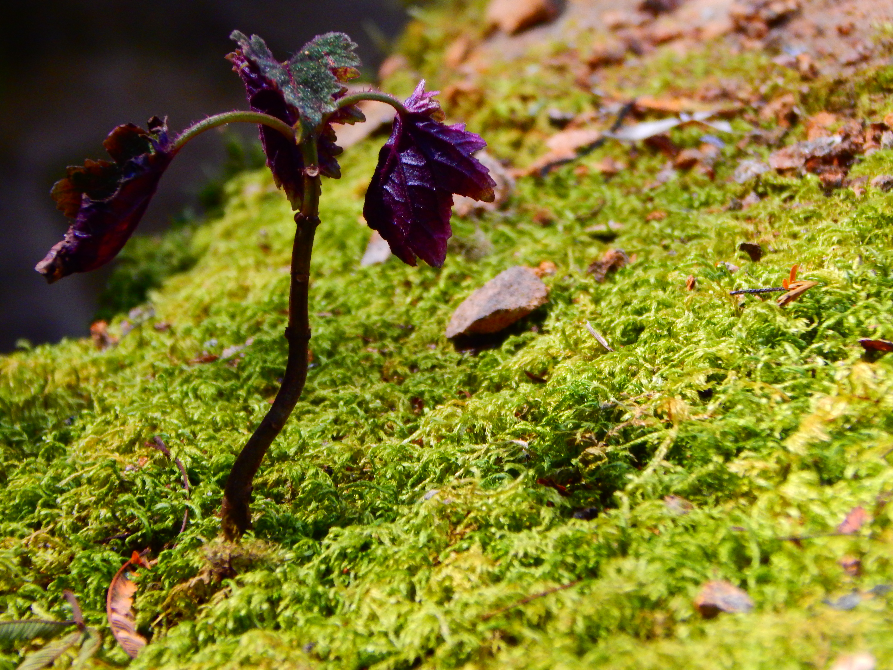
COMMENSALISM
Lichen Benefit, Trees Indifferent (usually)

Slide 30
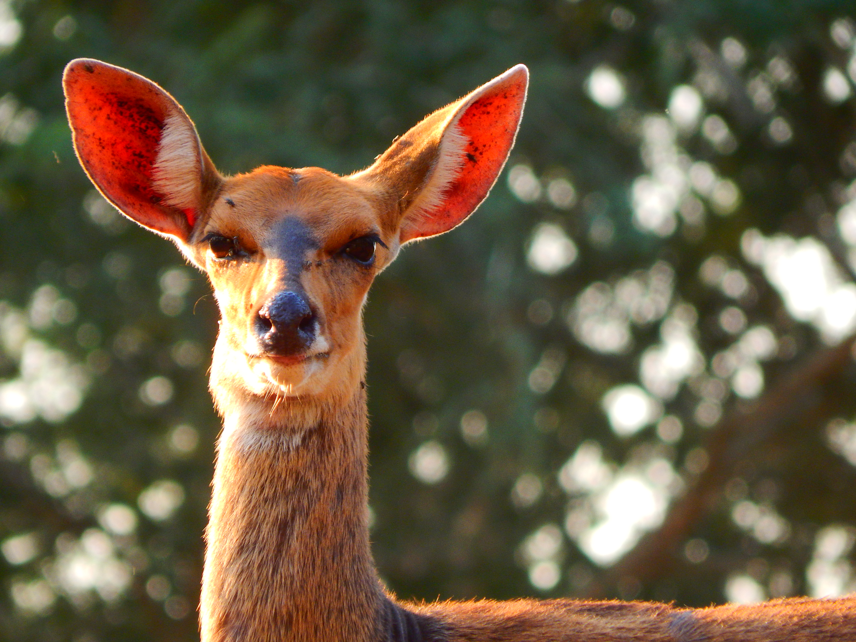
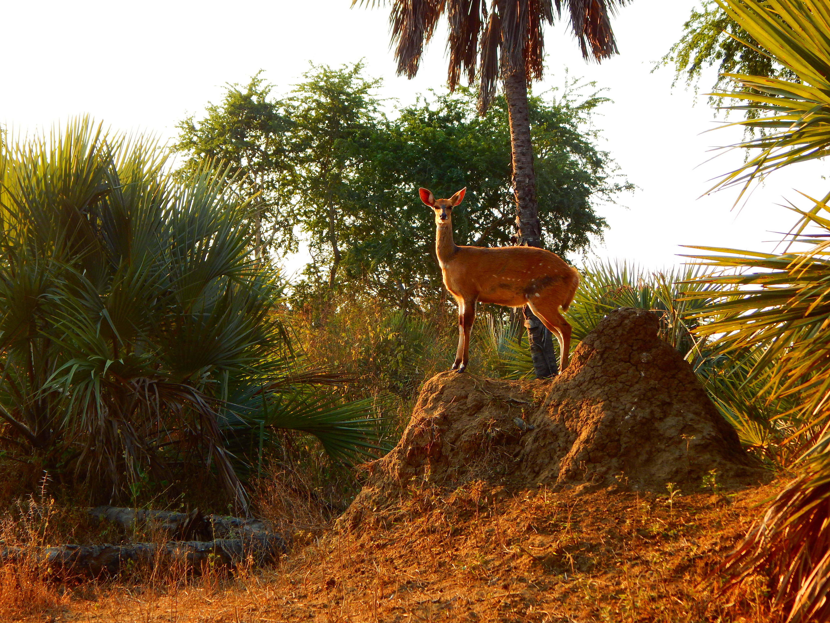
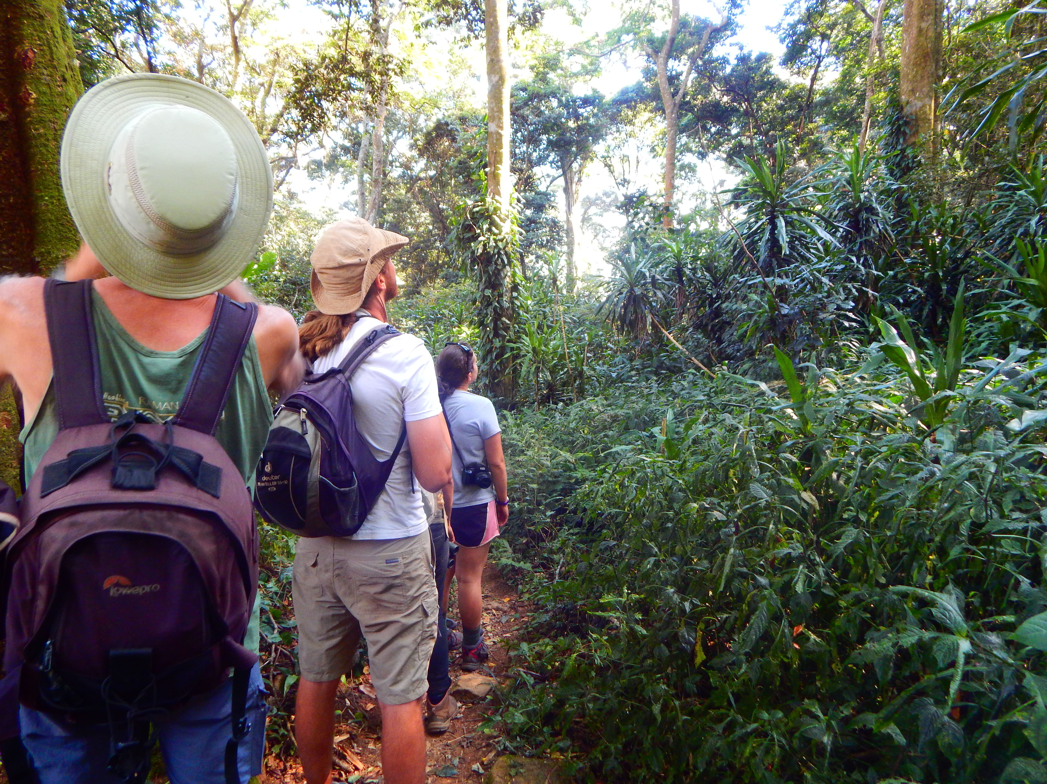
Interdisciplinary Field
Physiologists
Botanists
Microbiologists
Zoologists
Behavioralists
Notes:
Talk about bees and elephants

